Slide 1
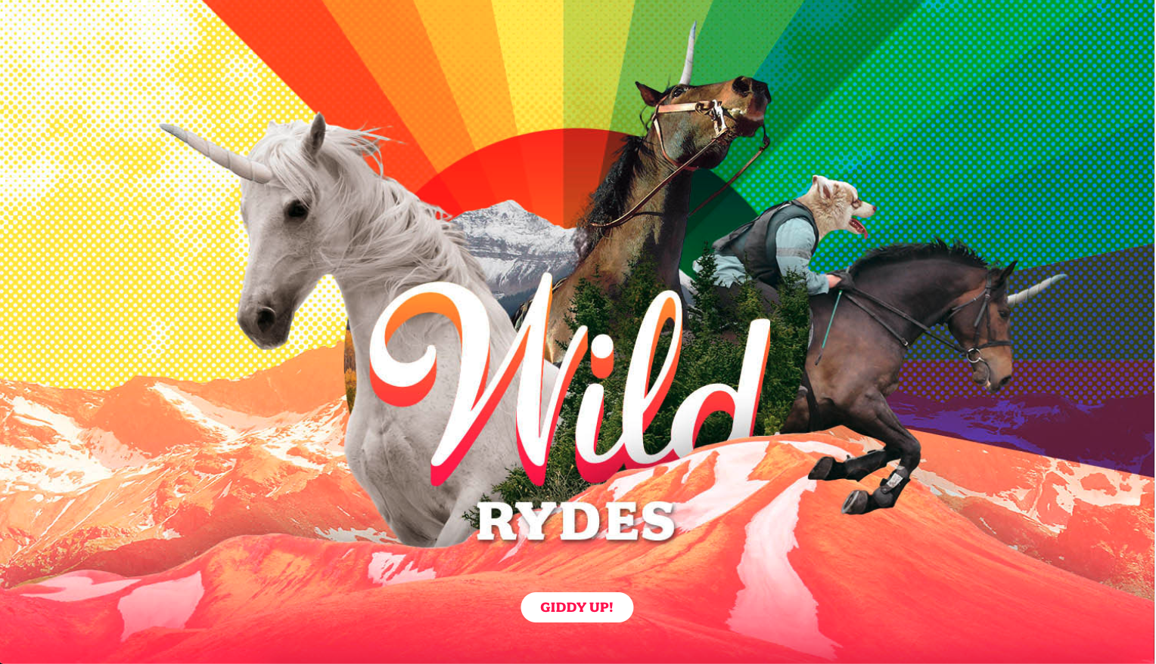
By Lorenzo Jiang

Slide 2
Executive Summary
Overview
Architecture Roadmap + Details
Amazon Cognito
Amazon S3
Amazon Lambda
Amazon API Gateway
Lambda Function
Design Choices
Testing
Costs

Slide 3
Overview
Objective: Create a serverless web application that allows users to request an unicorn ride by simply setting up their pick up location on a map.
Application Architecture: Wildrydes uses Lambda, API Gateway, DynamoDB, Cognito, and S3.
Programming Languages: HTML, CSS, and Javascript
Link: https://wildrydes-lorenzo-jiang.s3-us-west-1.amazonaws.com/ride.html

Slide 4
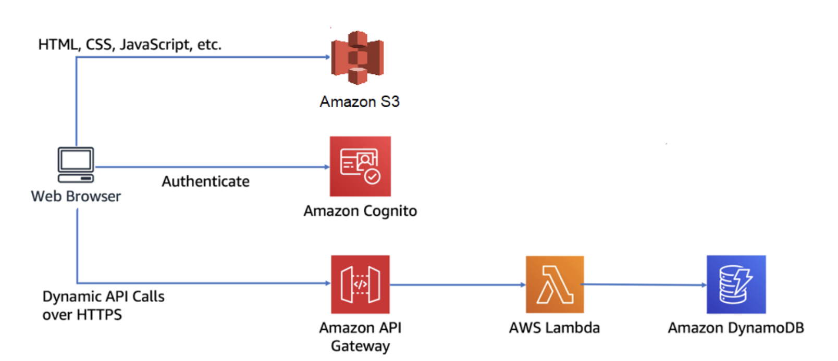
Architecture Roadmap

Slide 5
Architecture details
S3 stores and hosts the WildRydes static website written in HTML, Javascript, and CSS.
A Lambda function is invoked when the Javascript website sends and receives data from a public API by using API Gateway.
Amazon Cognito authenticates all the user information, registration, and sign in credentials and secures the API.
The username and location is passed between the web browser and the API.
It returns the chosen unicorn which is processed the by the Lambda function.
All the data from invoking the Lambda function gets stored in a DynamoDB table in which contains relevant metadata in regards to the unicorn ride requests.
For each ride, Lambda picks a random unicorn to assign and logs the ride entry to DynammoDB.

Slide 6
Amazon Cognito
Easy access for user registration and verification.
We can see which users verified their emails and we can manually verify an user account as well.
The user provides an email and a password (with certain requirements) and Amazon Cognito will send a confirmation email with a code.
After using the code to confirm an account, the user will be able to sign in with his/her credentials.
The authentication is done through the SRP and receives back a set of JSON JWT which verifies the identity of the user.
If an user does complete the registration process, the account status would be “unconfirmed” and the email verified sections would be false. Thus, the user cannot sign to request a ride.

Slide 7
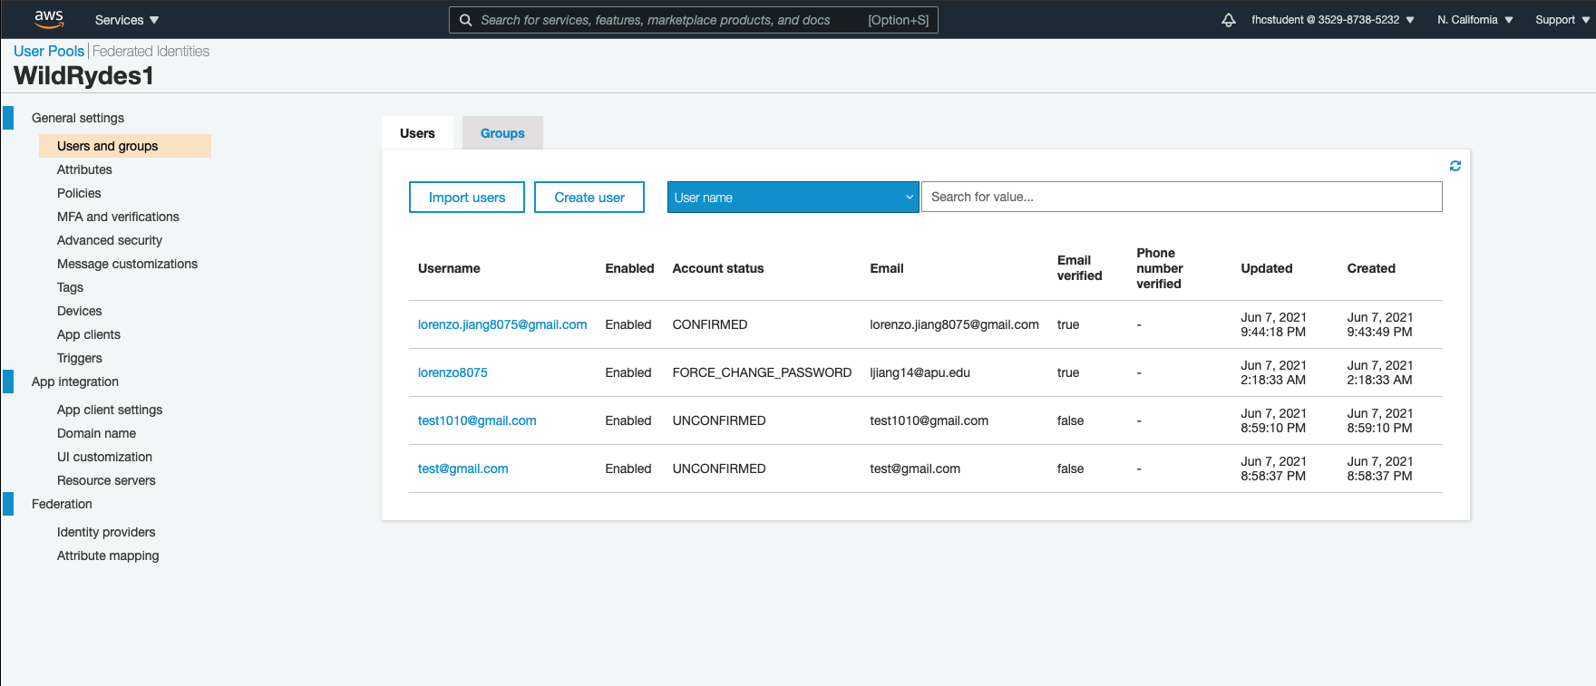

Slide 8
Amazon S3
Hosts statistic web content such as HTML, CSS, Javascript, images, and other files.
Doesn’t require any web servers to run WildeRydes on and it’s publicly available using the public URL.
Enhanced security by automatically enabling encryption of data.
For future project implementation, using S3 facilitates the integration with other services on AWS.
As the number of unicorn rides increases, scalability is simple as S3 can secure a large number of objects to operate high volume of simultaneous requests.

Slide 9
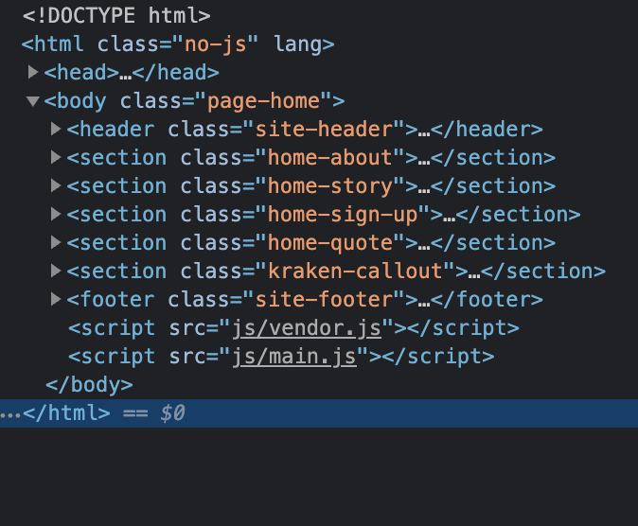
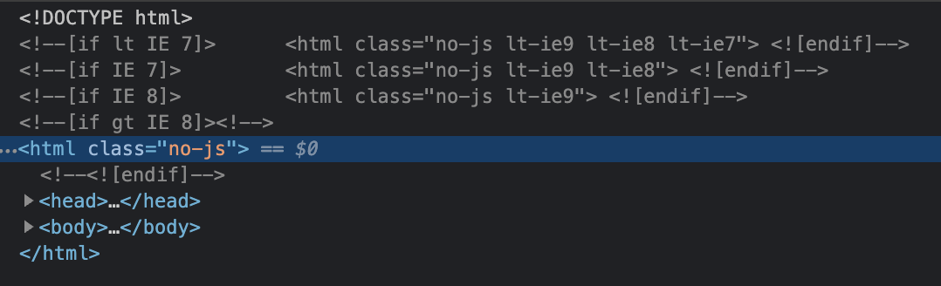
S3 files - index.html & signin.html

Slide 10
Amazon Lambda
The function in Lambda processes the user’s request for an unicorn ride.
Then selects an unicorn from the available fleet.
When the demand increases, Lambda allows Wild Rydes to run multiple functions at the same time with other Lambda functions.
Pay only for we need model
In the beginning of WildRydes life cycle, the number of requests will be quite low and Lambda charges the number times a function gets invoked.
Costs will be low when demand is low.
Easy to scale when demand pents-up.
Disadvantages:
Lack of control on the infrastructure
Infrastructure limitations and highly dependent on AWS
Costs can be higher than running our own servers if demand is extremely high
The Lambda function writes the log entry to DDB
Lambda function is invoked by API gateway which receives info from the user and pick a random unicorn to fulfill the ride.

Slide 11
Amazon DynamoDB Table
The requested unicorn from the Lambda function is recorded in a DynamoDB table.
Then, provides the details about the unicorn requested.
Allows the team to perform analytics on rides being requested
Scalable: able to store unlimited amount of data during peak demand.

Slide 12
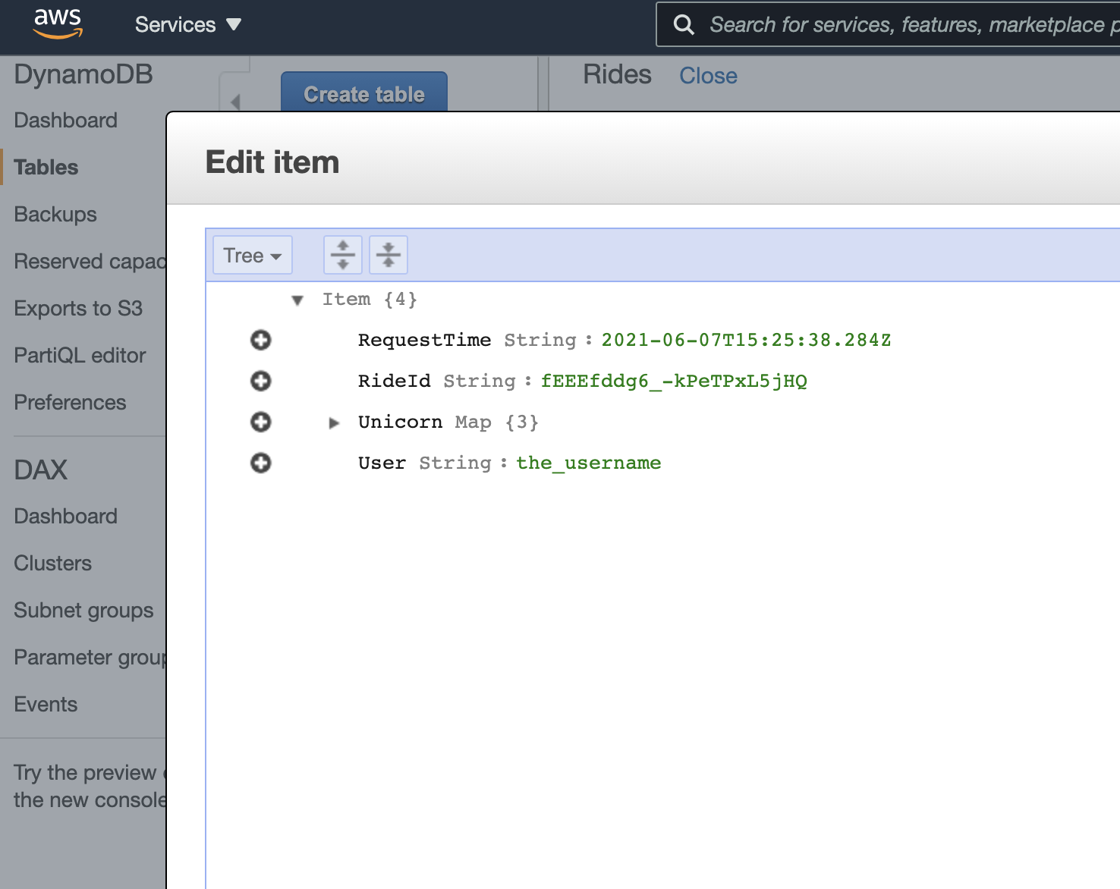
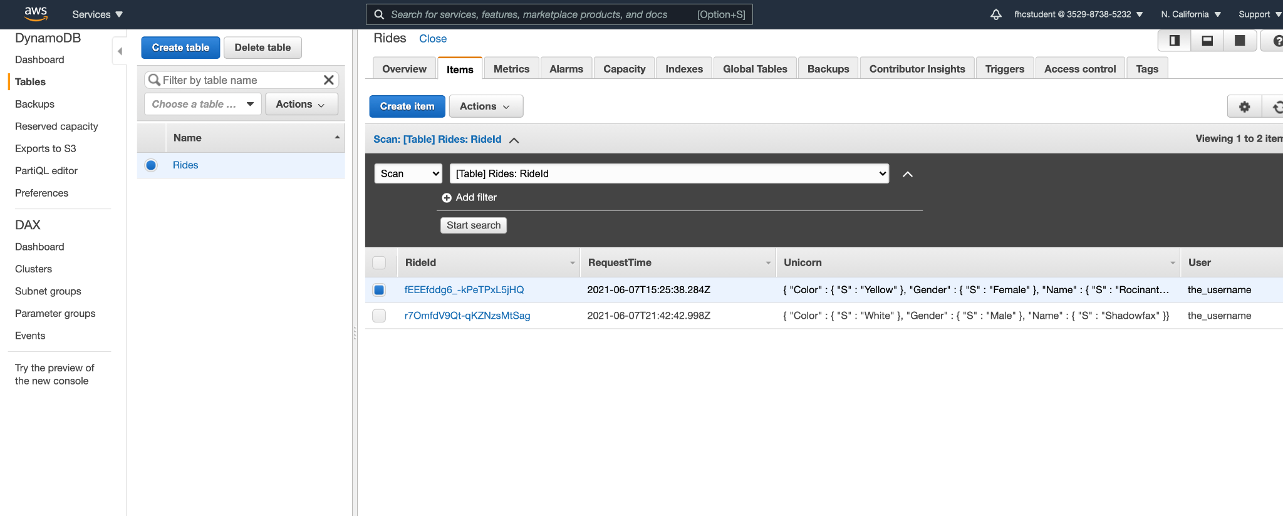
Rides log record

Slide 13
Amazon API Gateway
Amazon API Gateway exposes the Lambda function as a RESTful API and it is available to the public.
Turns the static website into a dynamic web site by adding client-side Javascript.
The Lambda dunctio uses the Lambda Jav

Slide 14
IAM for the Lambda function
The IAM user can automatically rotate access keys on virtual machine instances to verify that only trusted applications and users have the preassigned access at any given time.
We need the IAM role whenever we create a function and Lambda takes on the role when the function is being called.
It allows Lambda execution which writes to DDB and CW.

Slide 15
Design choices
us-west-1 is the location to implement WildRydes because it is the closest region for low latency to provide the best possible user experience.
I allowed public access to the website so everyone with a link can register and request an unicorn ride from WildRydes
I used the suggest name for the website address but it could be changed to wildrydes.com later on.
Users are only required to enter email and password to create an account because other information are not relevant at the moment.

Slide 16
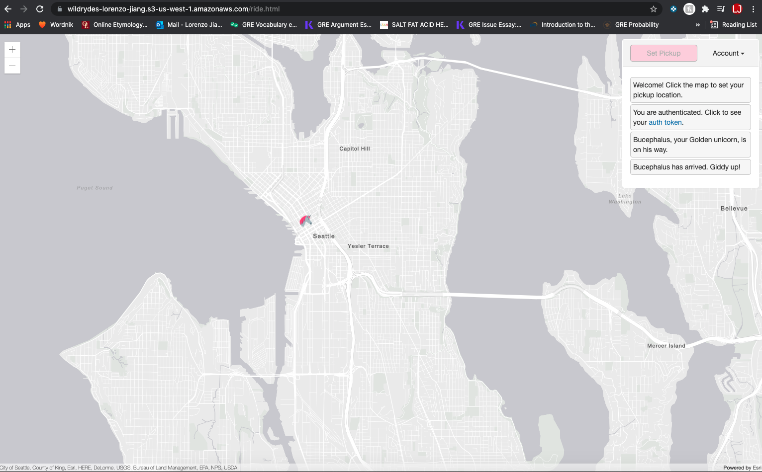
Testing: Unicorn Ride Request

Slide 17
Testing: Cognito User Registration

Slide 18
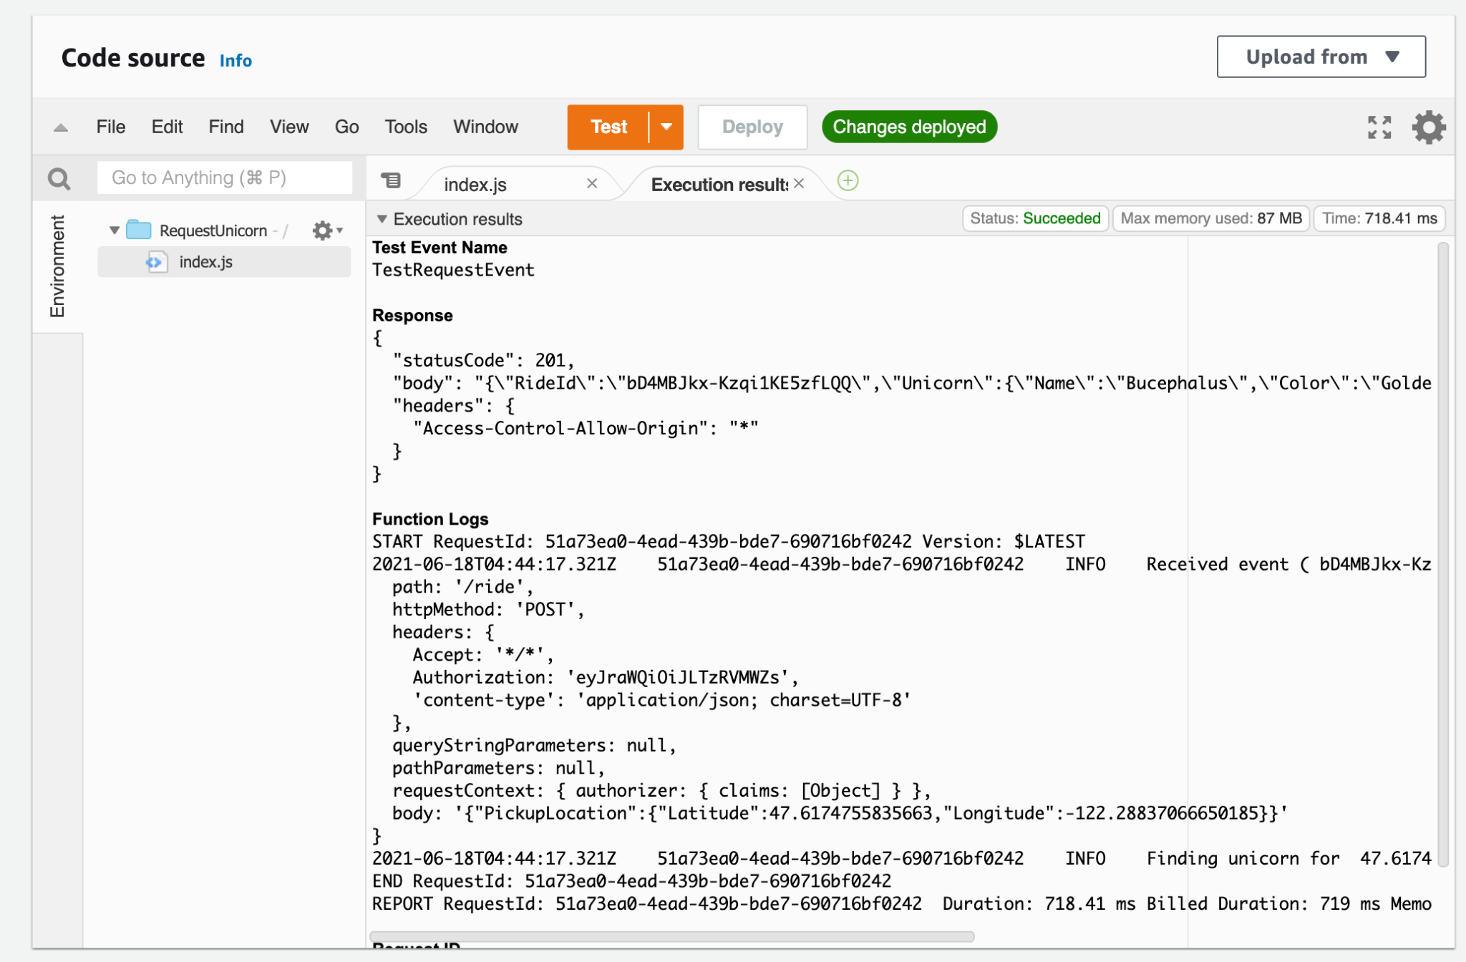
Testing: Lambda Test returns 201

Slide 19
Cost of Running WildRydes
WildRydes seeks to grow at rapid pace and the Enterprise Support Plan fits needs of this ambitious project.
$15k or 10% of first $150k, or 7% between $150k - $500k, or 5% between $500k-1m, or 3% over $1m.
The final cost is whichever is greater.
Number of customers: 3,000 - 5,000 daily active users
Number of requests per user: 1.25

Slide 20
Thank you!

